Slide 1

PlaatEnergy (Energy Data Logger)
Ing. W.B.J. van der Plaat
(Software Architect)

Slide 2

Question
How many energy is my house using daily?
How many gas is my heater using daily?
How many energy is my solar system deliver daily?

Slide 3

Idea
Lets create an application which measures everything
Records every minute energy and gas usage
Records every minute solar energy delivered
Records every minute environment temperature, humidity and pressure
Create User friendly Web GUI
Use low cost low energy hardware

Slide 4
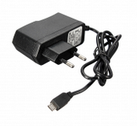
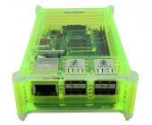

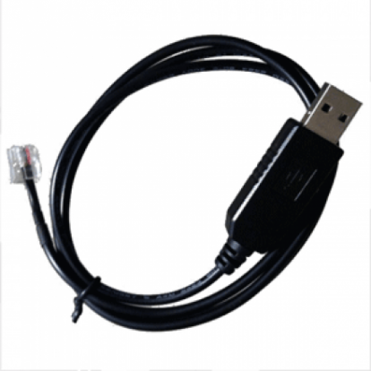
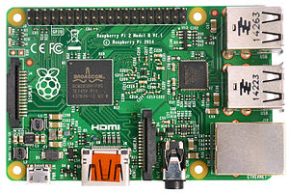
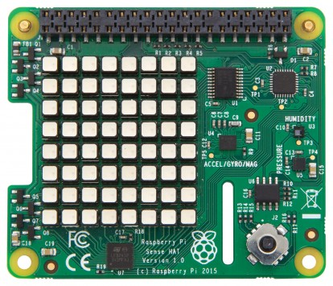
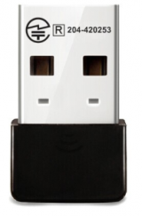
Used Hardware
Raspberry Pi 3B
USB to P1 Cable
Micro SD card
USB power supply
Raspberry Pi Case
USB Wifi Dongle
Pi Sense Hat (optional)

Slide 5

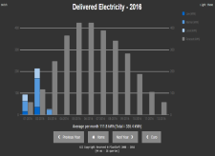


Hardware view – Configuration 1
P1 cable
Digital Energy
Meter
Raspberry Pi
PlaatEnergy
Sense Hat (Pi)
HDMI cable
USB cable
USB cable

Slide 6

Hardware view – Configuration 2
P1 cable
Digital Energy
Meter
Bluetooth
Digital Gas
Meter
Raspberry Pi
PlaatEnergy
Sense Hat (Pi)
Ethernet
or
Wifi
Router
PlaatEnergy
Reachable on
intranet
Intranet

Slide 7
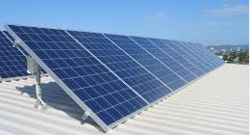
Hardware view – Configuration 3
Digital Energy
Meter
P1 cable
Solar
Converter
Raspberry Pi
PlaatEnergy
Sense Hat (Pi)
Ethernet
or
Wifi
Router
PlaatEnergy
Reachable on
intranet
Intranet

Slide 8
Hardware view – Configuration 4
P1 cable
Digital Energy
Meter
Bluetooth
Digital Gas
Meter
Solar
Converter
Raspberry Pi
PlaatEnergy
Sense Hat (Pi)
Wifi
Ethernet
or
Wifi
Router
Intranet
PlaatEnergy
Reachable on
internet
Router
Internet

Slide 9
Hardware view – Configuration 5
P1 cable
Energy
Meter
Bluetooth
Gas
Meter
Solar
Converter
Solar
Converter
Solar
Converter
Raspberry Pi
PlaatEnergy
Sense Hat (Pi)
Wifi
Wifi
Wifi
Router
Wifi
Intranet
HDMI kabel
PlaatEnergy
Reachable on
internet
PlaatEnergy
slide show
via
monitor
Router
Internet

Slide 10
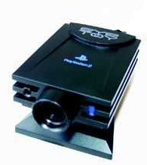
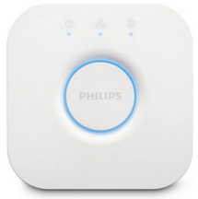

Hardware view – Configuration 6
P1 cable
Digital Energy
Meter
Bluetooth
Digital Gas
Meter
Solar
Converter
Raspberry Pi
PlaatEnergy
Sense Hat (Pi)
Wifi
Ethernet
or
Wifi
Router
Wifi
Intranet
USB
USB
PlaatEnergy
Reachable on
internet
Router
Internet

Slide 11
PlaatEnergy Software Architecture
Google Charts
Weather Service
json
Presentation Layer
php/css/js
Business Logic + Data Aggregation algorithm layer
php
Database Layer
sql
Solar Converter
sensor scripts
Energy Meter
sensor scripts
Environment
sensor script
Display
sensor script
php/python
Operating System (Linux Debian)
unix

Slide 12
PlaatEnergy Key features
Measure each device every minute
User friendly web interface
Show real-time, historical and forecast data
Show financial data
Support measurement corrections
Export measure data to CSV and SQL
Open Source and free to use!
Upgrade detection + automatic data model patching
Secure access to Web GUI and settings

Slide 13
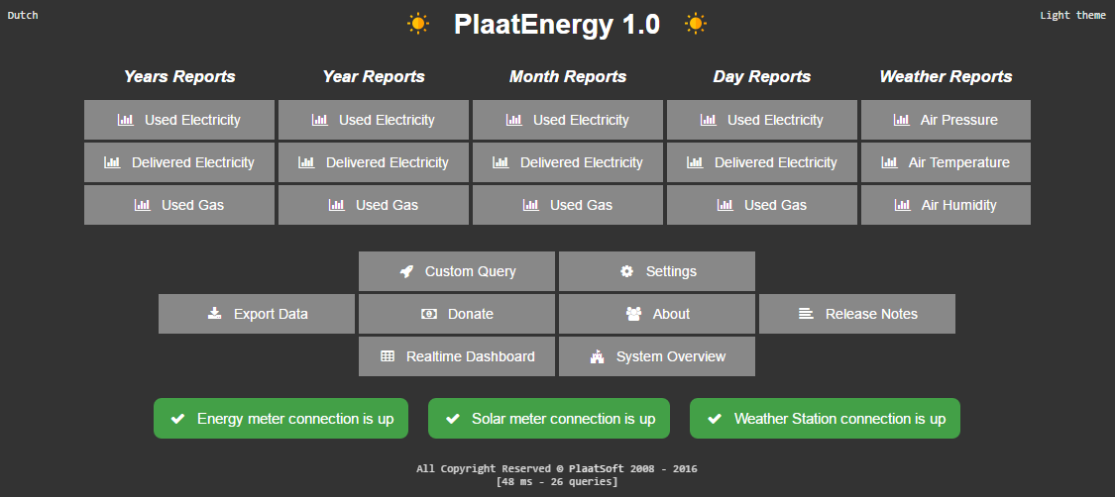

Slide 14
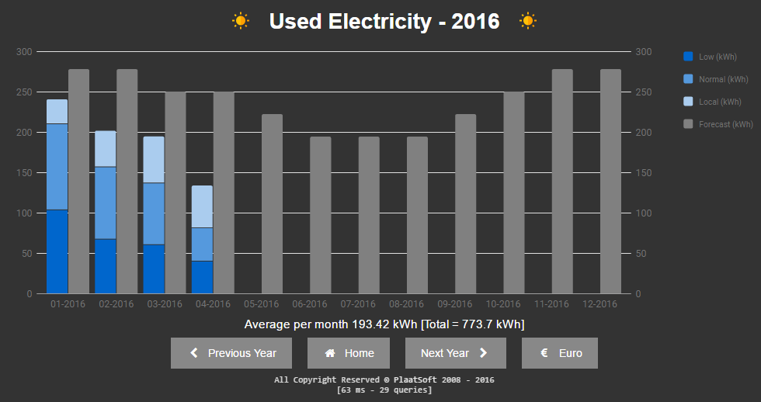

Slide 15
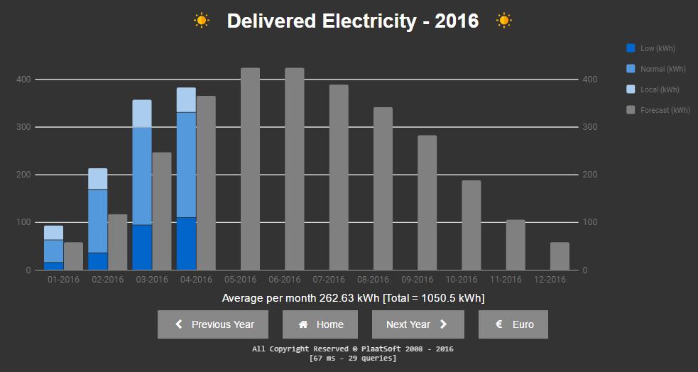

Slide 16
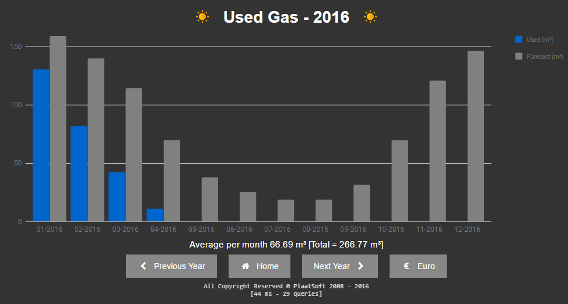

Slide 17
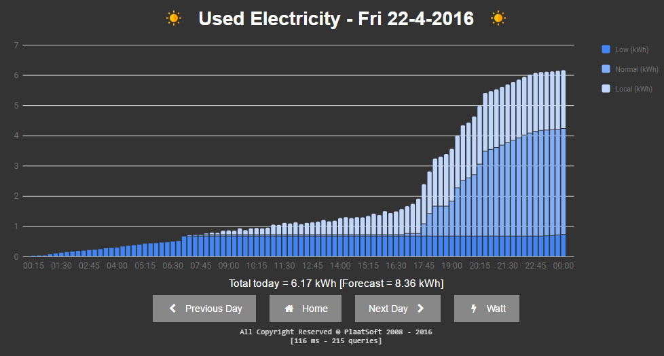

Slide 18
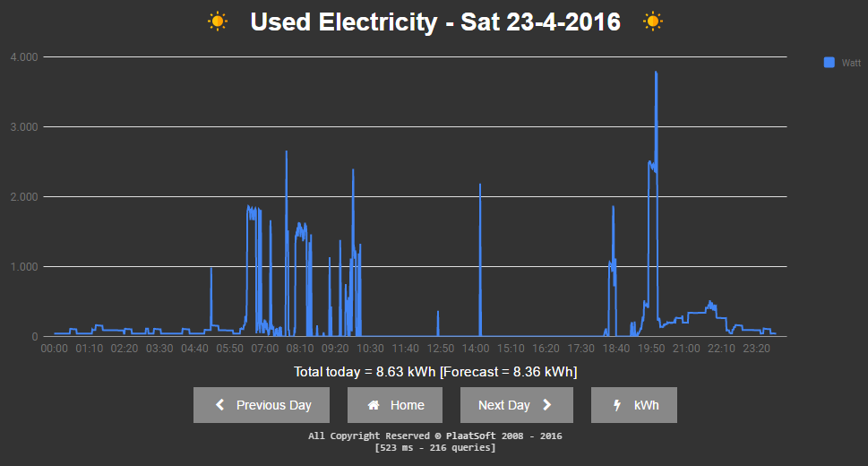

Slide 19
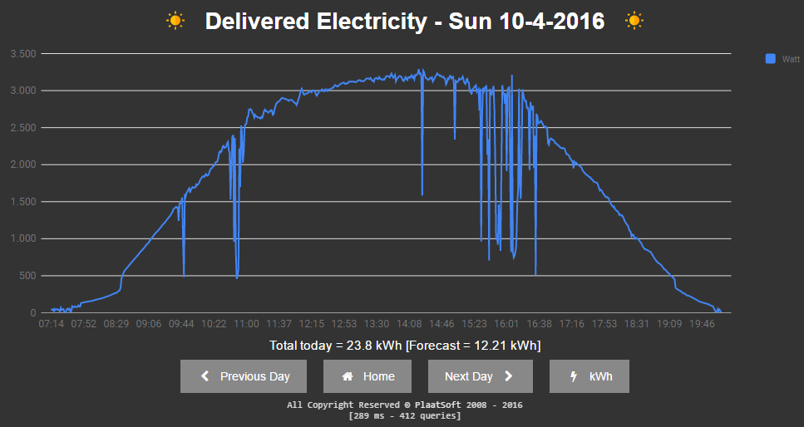

Slide 20
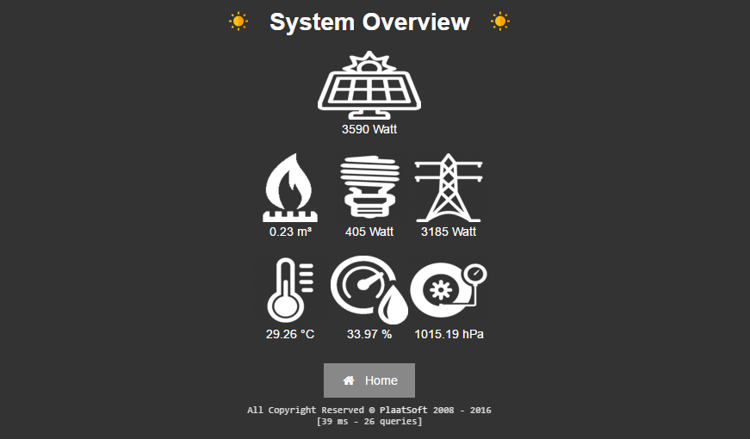

Slide 21
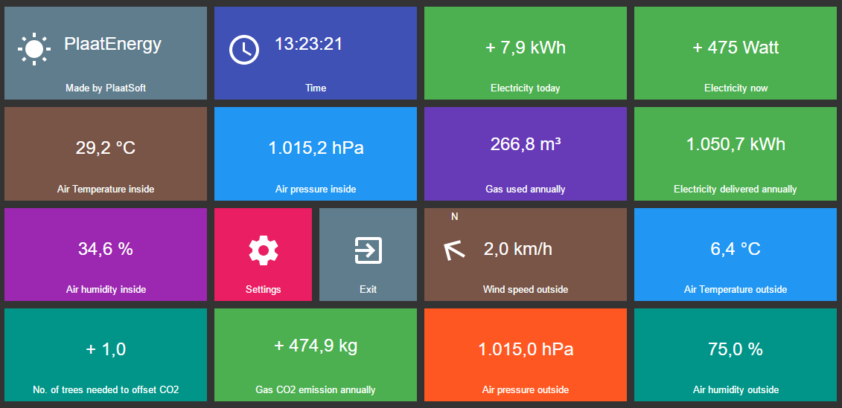

Slide 22
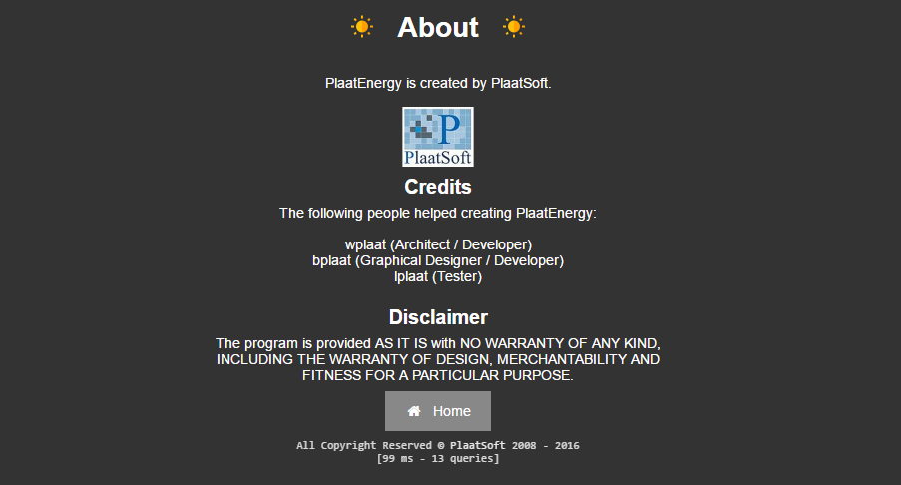

Slide 23
Conclusion
My energy / gas use is dropped with 25% / 50% because I am more aware now.
PlaatEnergy is downloaded ca. 100 times now
“Customers” sending great feedback back ☺

Slide 24
Feature Plans
Add support for infrared energy meters.
Add Google Nest product support
Nest thermostat. Control my thermostat remote
Nest Protect. Receive notification when gas and/or fire is detected
Add Philips Hue product support
Control lights in my house
New idea’s are welcome!

Slide 25


